Slide 1
CLASS:- BCS-III, DIV-A
PROJECT NAME :- CREAMY ACRES DAIRY FARM
GUIDANCE OF MISS. MANE M.M.
STUDENT NAME | ROLL NO
1) KARAN SANJAY YEWALE | 124
2) ROHAN KRUSHNAT MANDAVE | 57

Slide 2
1) INTRODUCTION :- Our farm have, two notable breeds Gir and Sahiwal cows stand out for their excellent milk production and adaptability to local climates. These indigenous breeds have been keeping in our dairy farm, showcasing resilience and productivity that contribute significantly in our dairy farm. Through this website our dairy farm delivers all over the our products directly to the customer, so the customer get fresh and pure products. like milk, curd, buttermilk, ghee, paneer, milkpowder and so many good quality organic manure are also sold to the farmers. our farm provides training on dairy management This training is provided at our farm where 1days residential training facility is available with us.

Slide 3
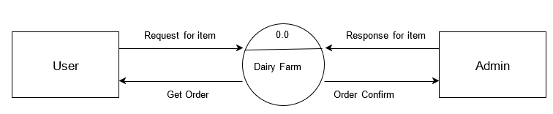
2) DFD :- Zero Level DFD

Slide 4
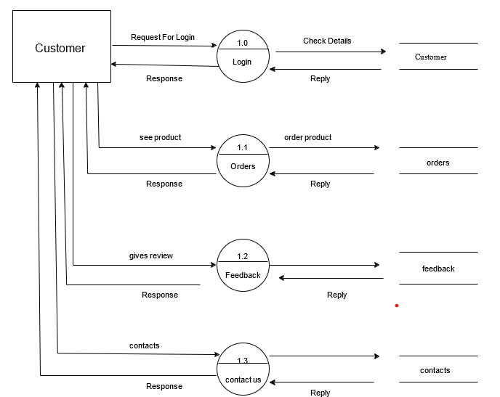
First Level User Side DFD

Slide 5
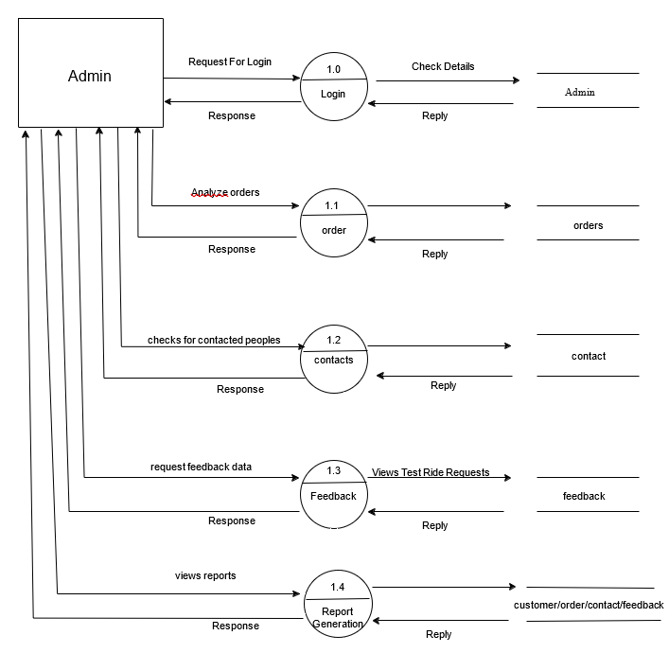
First Level Admin Side DFD

Slide 6
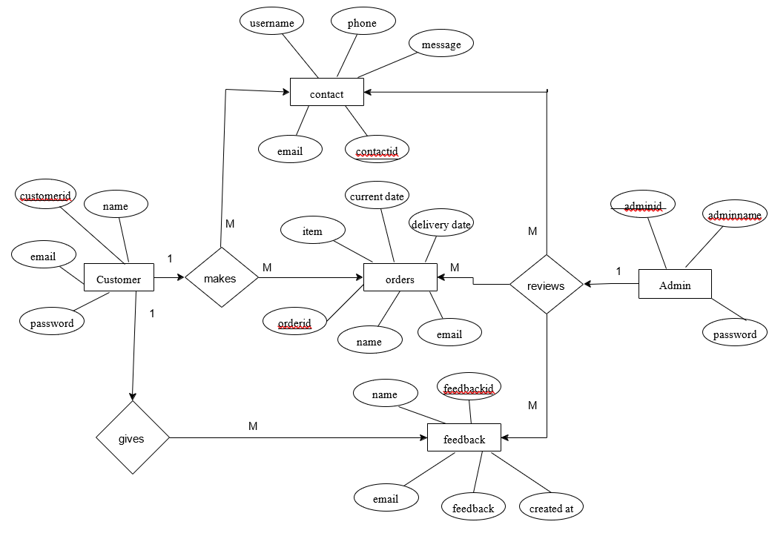
ERD

Slide 7
3) HARDWARE / SOFTWARE REQUIREMENTS Hardware Requirements:- 1. Hard Disk:- Minimum of 120GB 2. Processor:-Ryzen 5 3. RAM:- 4GB 4. Keyboard:- USB Wired or Wireless 5. Mouse:- Two Primary Buttons, Clickable Scroll Wheel Software Requirements:- 1. Operating System:- Windows 11 2. Developing tool:- Visual studio code 3. Database(Back-end):- PHP-My SQL 4. Front-end:- Html, Css, Javascript

Slide 8
4) DATABASE :-

Slide 9
5) SCREEN INPUT / OUTPUT REPORT :-

Slide 10
6) CONCLUSION :- The Dairy Farming website project aims to modernize the dairy farming industry by providing a comprehensive digital platform for managing various aspects of farm operations. By integrating technology with traditional farming practices, the website will help farmers streamline their processes make informed streamline their processes, make informed decisions, and ultimately increase productivity and profitability and our customers get fresh, pure and healthy milk products, and farmers get best quality of organic manure.

Slide 11


